Slide 1
Lecture: Large Scale Recognition
Juan Carlos Niebles and Ranjay Krishna
Stanford Vision and Learning Lab

Slide 2
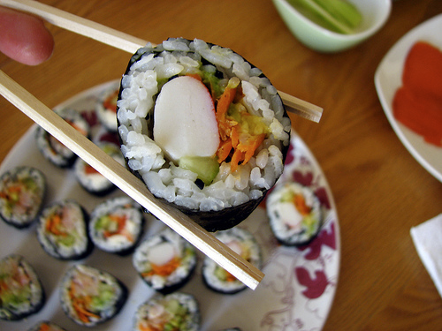
California Roll
Ingredients: Rice, Seaweed, Crab, Cucumber, Avocado
Calories: 40
Fat: 7g
Carb: 40g
Protein: 5g
Gluten Free
Notes:
For example, I’d like my computer to be able to tell me what I’m eating, whether it’s healthy.

Slide 3
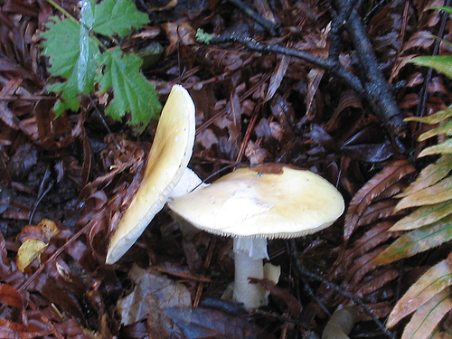

Amanita phalloides
http://en.wikipedia.org/wiki/Amanita_phalloides
TOXIC. DO NOT EAT
Notes:
Or what not to eat

Slide 4
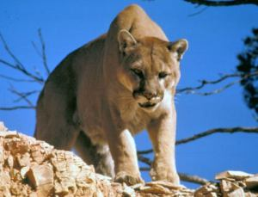
Mountain Lion
DO NOT RUN
Raise arms to appear larger.
Show your teeth
Notes:
Or how not to be eaten.

Slide 5
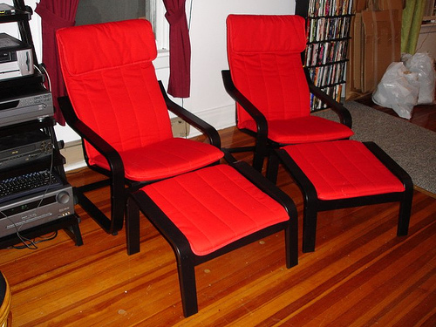
IKEA POANG Chair
ON SALE
$29.00 at ikea.com
Notes:
I’d also like my computer to give me shopping advice,

Slide 6
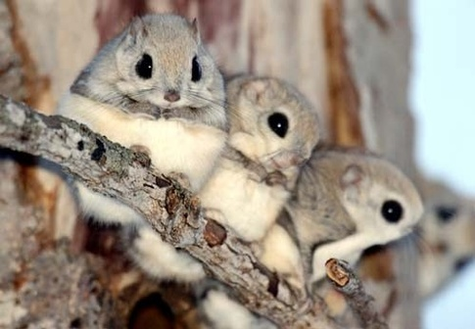
Mornonga
(Japanese flying squirrel)
Inhabits sub-alpine forests in Japan. Nocturnal. Eats seeds, fruit, tree leaves (Wikipedia)
Notes:
Or just satisfy my curiosity.

Slide 7

I wish my computer could recognize EVERYTHING
Notes:
In fact, I’d like my computer to recognize everything in the visual world

Slide 8
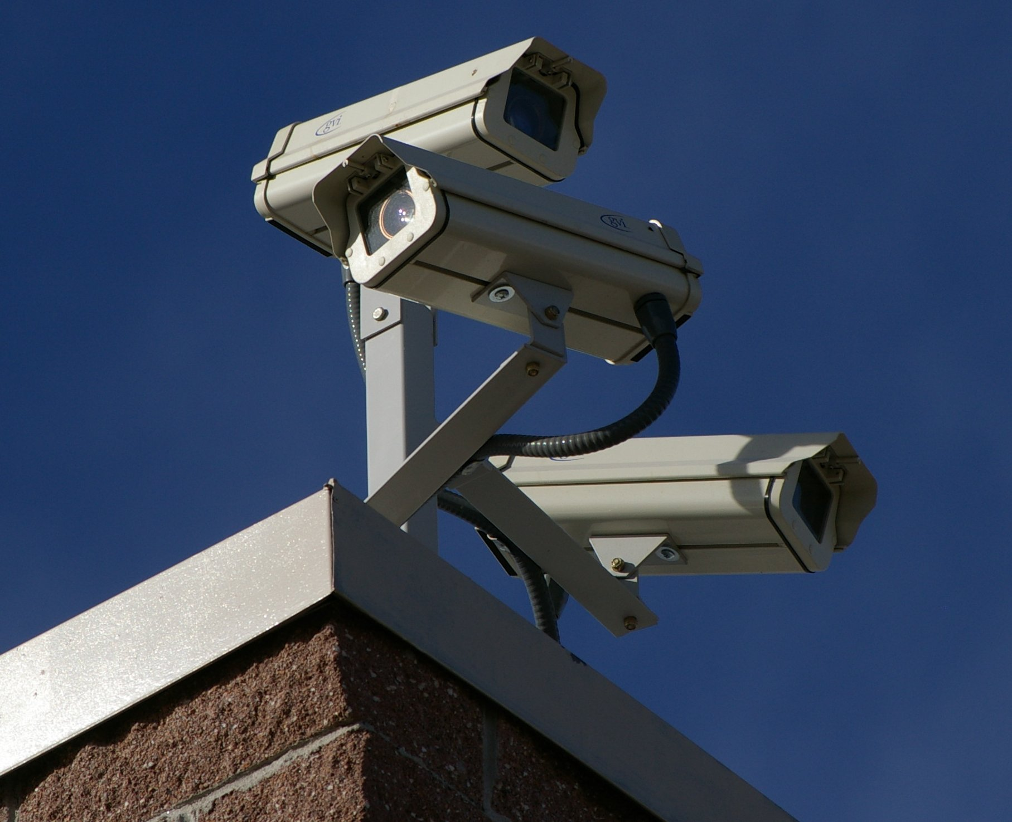
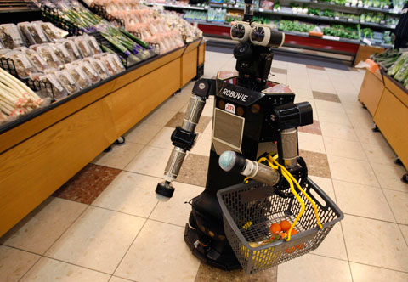
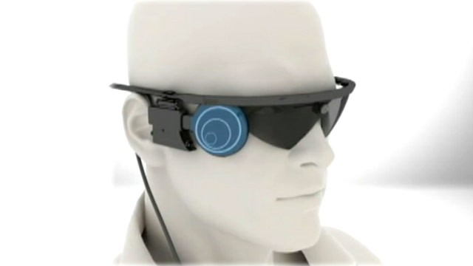
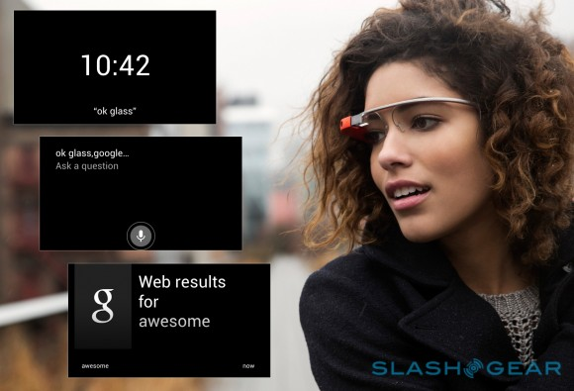
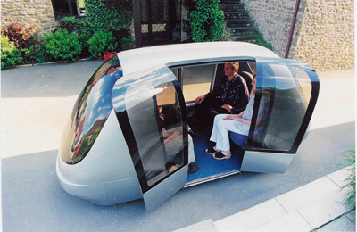

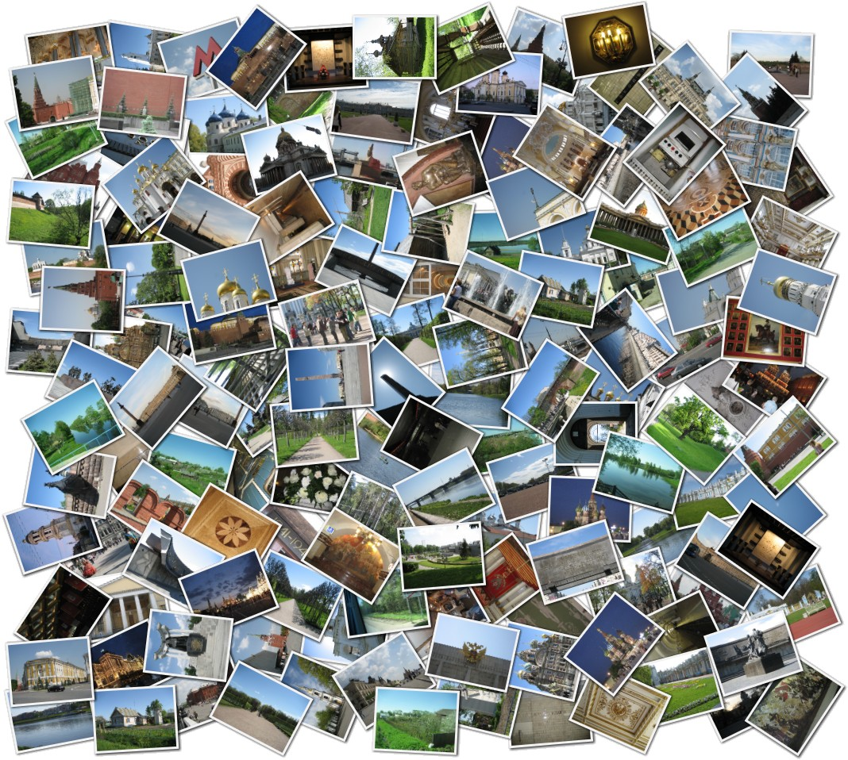
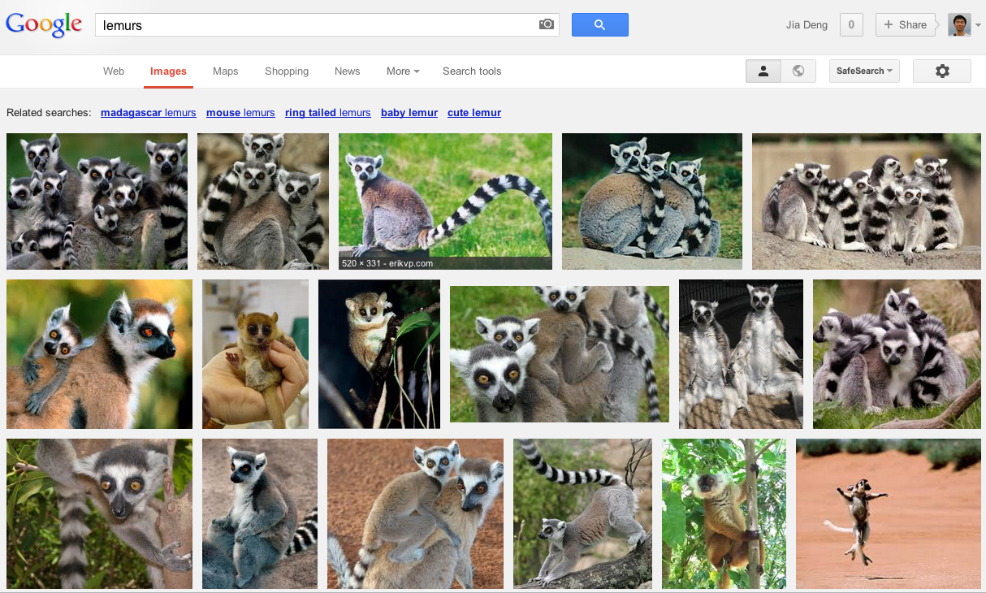
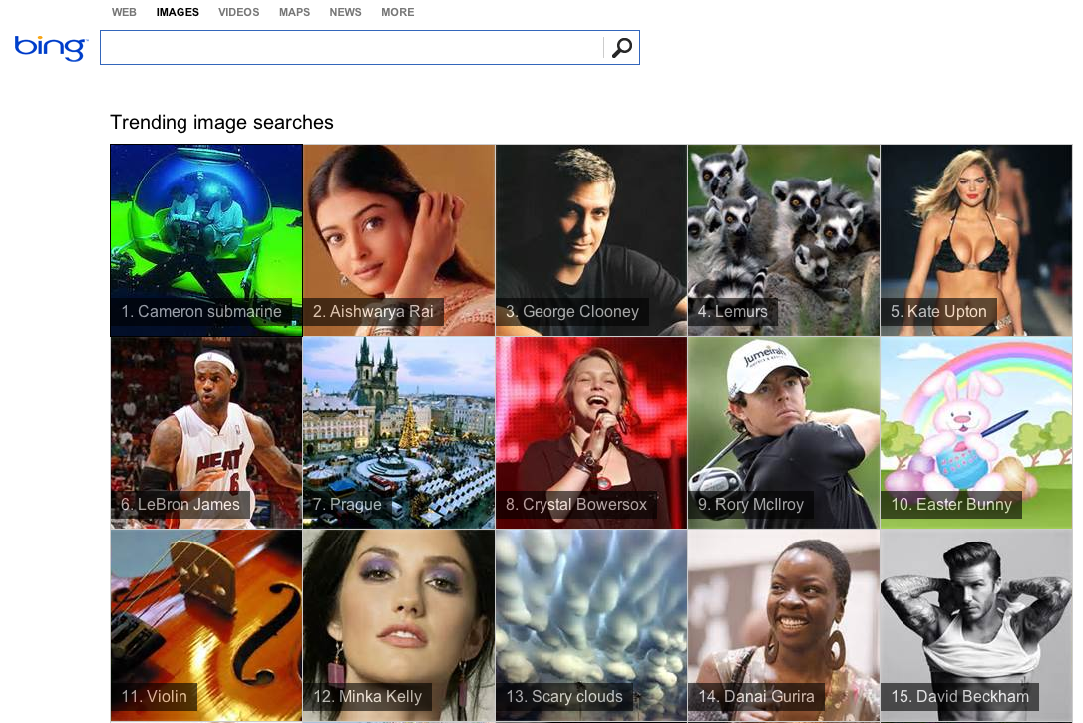

Surveillance
Robotics
Assistive tools
Recognition Engine
Wearable devices
Driverless cars
Smart photo album
Image search
Mining social media
Notes:
This is because recognition is the key AI problem of so many applications, from surveillance, robotics, assistive tools, wearable devices, driverless cars, to smart photo album, image search and mining social media. It is one of the grand challenges of computer vision and decades of research has been dedicated to it.

Slide 9
What can computers already recognize?
Notes:
So where are we now? What can computers already recognize?

Slide 10
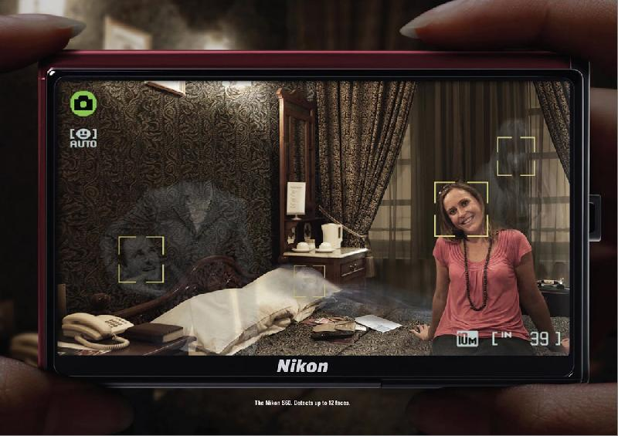
Notes:
We know that face recognition is a great success and is now almost ubiquitous

Slide 11

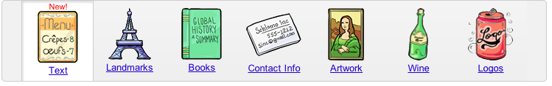
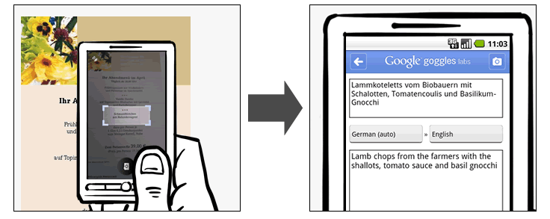
Notes:
We also know that computers can recognize things like text, landmarks, and logos. For those objects, you can take a photo with your phone, and the google goggles app can tell you what it is. These things work because retrieving near-duplicate images is a solved problem. However, this is a very limited set and pretty much everything else doesn’t quite work.

Slide 12
What’s the next to work on?
Coffee Mugs!
Notes:
Now, here’s question for you. If you were a computer vision researcher, what object should you work on next? What’s your favorite object? When I started graduate school, I thought about this very hard. Here’s answer I came up with [click]. Coffee mugs. Why coffee mugs? More than 100 million americans drink coffee every day.

Slide 13
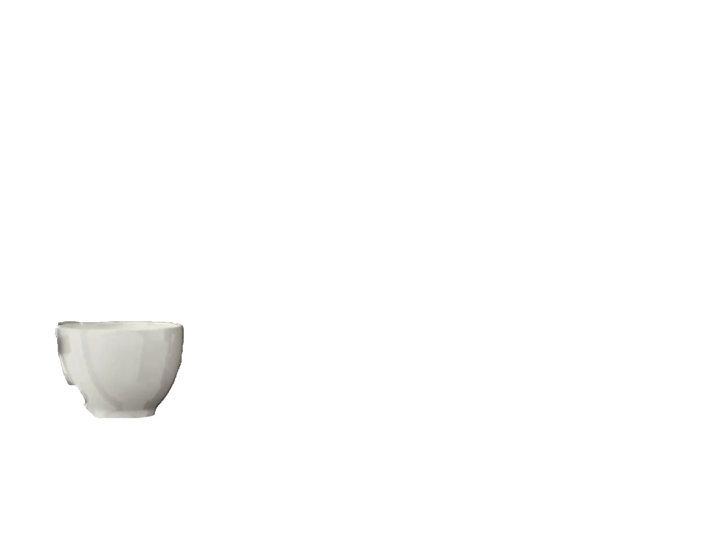
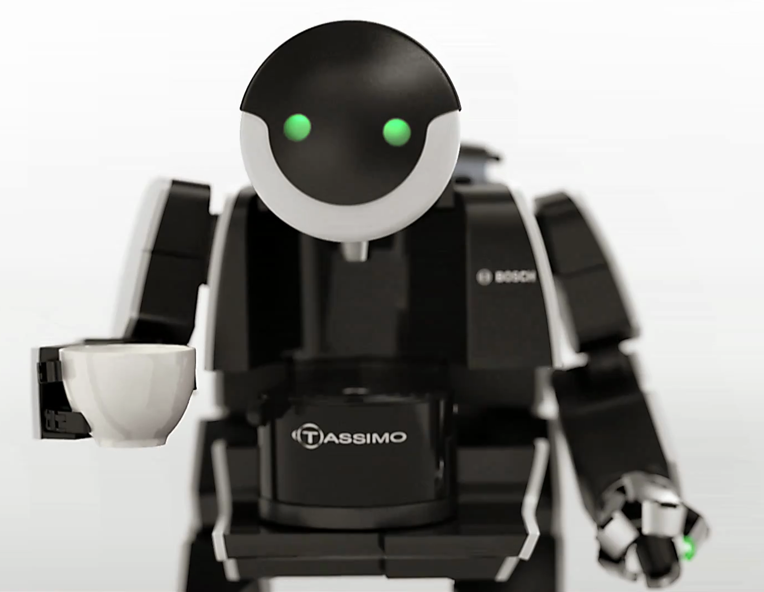
Notes:
why wouldn’t you want your personal robot to bring you coffee?

Slide 14
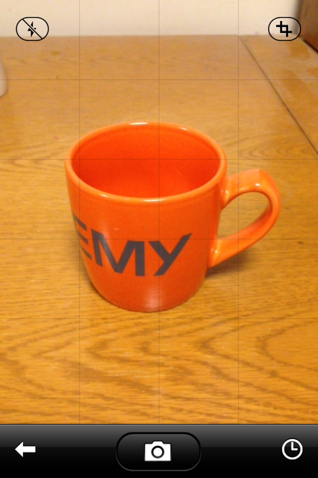
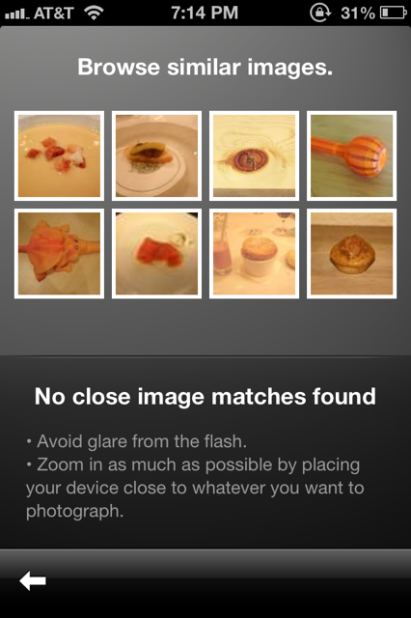
Notes:
Also, clearly it’s not working. This is my coffee mug and google goggles has no idea what it is. Not even close.

Slide 15
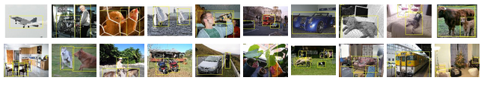
PASCAL VOC [Everingham et al. 2006-2012]
Airplane
Bird
Boat
Bike
Bottle
Bus
Car
Cat
Chair
Cow
Dining table
Dog
Horse
Motorbike
Person
Potted plant
Sheep
Sofa
Train
TV monitor
No Coffee Mugs!
Notes:
Most importantly, not many people are trying to make it work. This is PASCAL VOC, the most important recognition benchmark and the de facto international standard for between 2006 and 2012. There are only 20 object classes and there are no coffee mugs.

Slide 16
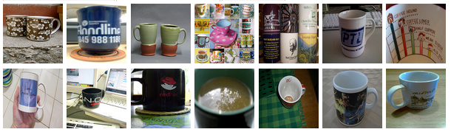
Coffee Mugs!
The rest of the talk will be about
Notes:
So the rest of this talk will have to be about coffee mugs and I’ll tell you everything about coffee mugs.

Slide 17
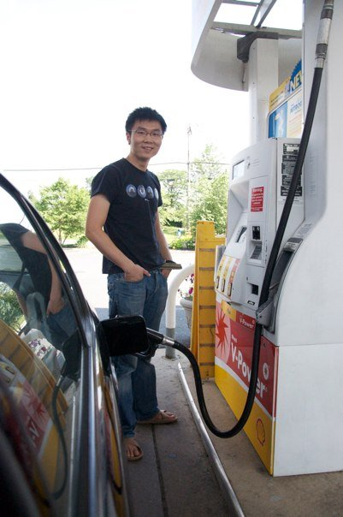

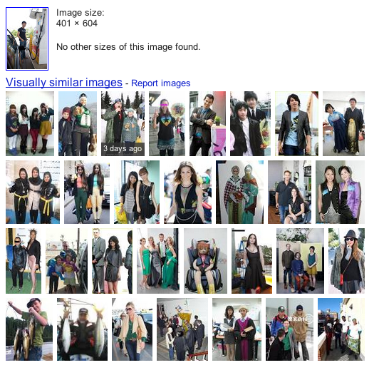
What about
Gas Pumps!
Notes:
But what about gas pumps? This is a photo from my road trips and google couldn’t recognize it either. If I want my computer to organize my photo album, how can it not recognize gas pumps?

Slide 18
Coffee Mugs
The rest of the talk will be about
And Gas Pumps
And Solar arrays
Radio
First aid kit
Spacesuit
Oxygen Cylinder
What do they have in common?
Notes:
So besides coffee mugs, I will talk about gas pumps. But there are other things I care about, such as solar arrays, radio, first aid kit, spacesuit, oxygen cylinder. What do they have in common? According to NASA, these are the things you should bring when you take a vacation on Mars. You see where this is going. If you believe in equal opportunity, there is only one solution.

Slide 19
Let’s work on recognizing EVERYTHING
Notes:
That is, we need to tackle of problem of recognizing everything.

Slide 20
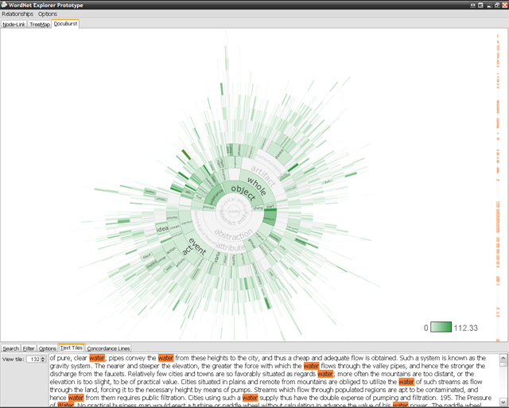




How many things are there?
WordNet
10K+
[Biederman ’87]
60K+
product
categories
4.1M+
articles
80K+
English nouns
[Miller ’95; Fellbaum ’98]
3.5M+
unique tags
[Sigurbjörnsson & Zwol ’08]
Notes:
What does this mean exactly? In other words, how many things are there? Various estimates exist. In the 80s, pychologists have estimated that there are at least 10K categories. There are more than 60K products sold on ebay. Wikipedia has millions of entries. All these estimates tell us that this is a very very large-scale problem.

Slide 21

From 20 classes to Millions?
PASCAL VOC [Everingham et al. 2006-2012]
Notes:
So to make computers recognize everything, we need to take a huge leap from 20 to tens of thousands, or millions of classes. How is it possible? What has changed from the past decades to make it even conceivable?

Slide 22
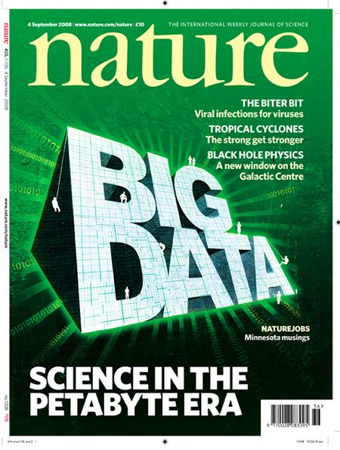
Notes:
The answer is big data. In particular [click], big data from the internet.

Slide 23
Big Data from the Internet

Slide 24
Global Consumer Internet Traffic Per Month
83 EB
63 EB
48 EB
38 EB
30 EB
21 EB
2011
2012
2013
2014
2015
2016
Source: Cisco
Notes:
It’s no longer news any more that there is a staggering amount of data on the internet. According to cisco, 2016 internet traffic per month reached 83 exabyte. That’s 83 million TB in a single month.

Slide 25


83 EB
72 hours of videos / min
300 million images / day
Visual
86%
2016
Source: Cisco
Notes:
Where do these data come from? It turns out that 86% of them are visual. People are uploading 72 hours of videos per minute to youtube and 300 millions image per day to facebook.

Slide 26
Big Data from the Internet
→ The Internet can teach EVERYTHING
Notes:
With so much data on the internet, one implication is that the internet can teach us everything.

Slide 27

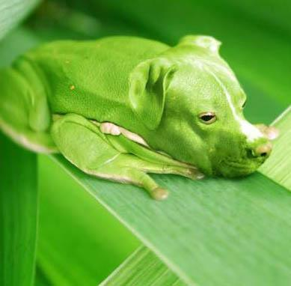
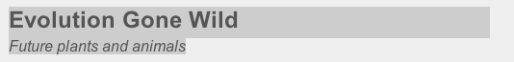
http://www.worth1000.com/contests/12705/contest
Notes:
For example, if I ask you what is pitbullfrog. What would you do? [click]Well, you would go to google and here’s what you would find [click]. It turns out to to be a creature from a photoshop contest about evolution gone wild.

Slide 28
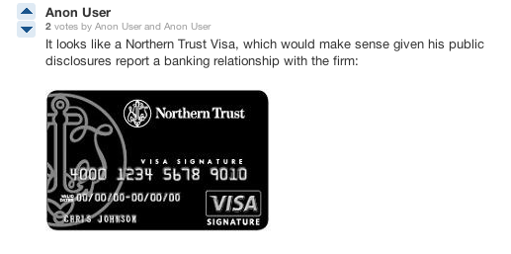
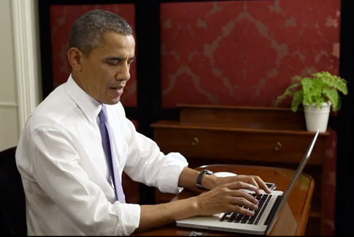

What kind of credit card is President Obama
using in this video of him donating to his campaign?
Notes:
Let’s look at another example. What do you see? what could a deep question about this picture? Here’s one: [click] what kind of credit card is president obama here? [click] it is this very blurry thing next to the laptop. You can’t find the answer if you just google. How would you get an answer? You can ask people on the internet. You could actually post it on quora, a question and answer hub, and within a few hours somebody would give a plausible guess. Isn’t this amazing?

Slide 29

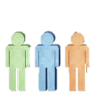
The Internet: Machines + Crowd
Big Data
Teach machines to recognize EVERYTHING
Notes:
So hopefully I have convinced you that we can learn almost everything from the Internet, specifically from the interconnected servers and the crowd. And our hypothesis is that we can also make machines do this. We can let machines learn to recognize everything through big data from the internet.

Slide 30
PASCAL VOC
10K+
[Biederman ’87]
20
[Everingham et al.’06-’12]
Goal: Build a recognition engine on EVERYTHING
10K classes
Notes:
And today let’s make a really concrete goal. Let’s pretend the everything means 10K classes and let’s build a recognition engine that operates on 10K classes.

Slide 31

[Deng et al. 2009]
www.image-net.org
22K categories and 14M images
Animals
Bird
Fish
Mammal
Invertebrate
Plants
Tree
Flower
Food
Materials
Structures
Artifact
Tools
Appliances
Structures
Person
Scenes
Indoor
Geological Formations
Sport Activities
Notes:
And we do this for the entire wordnet. And this is the core of the imagenet project, Today imagenet has 22K categories and 14M images, all hand labeled by humans. It covers a wide range of categories from animals, plants, to people and activities. It is the largest labeled image dataset that’s freely available to researchers.

Slide 32
ImageNet, 14M
[Deng et al. ’09]
Number of Labeled Images
SUN, 131K
[Xiao et al. ‘10]
LabelMe, 37K
[Russell et al. ’07]
PASCAL VOC, 30K
[Everingham et al. ’06-’12]
Caltech101, 9K
[Fei-Fei, Fergus, Perona, ‘03]
Notes:
And we can compare the scale of images to prior datasets in terms of number of labeled images. This is caltech101, then we have PASCAL VOC, LabelMe, Lotus Hill, and we see that ImageNet is is orders of magnitude bigger.

Slide 33
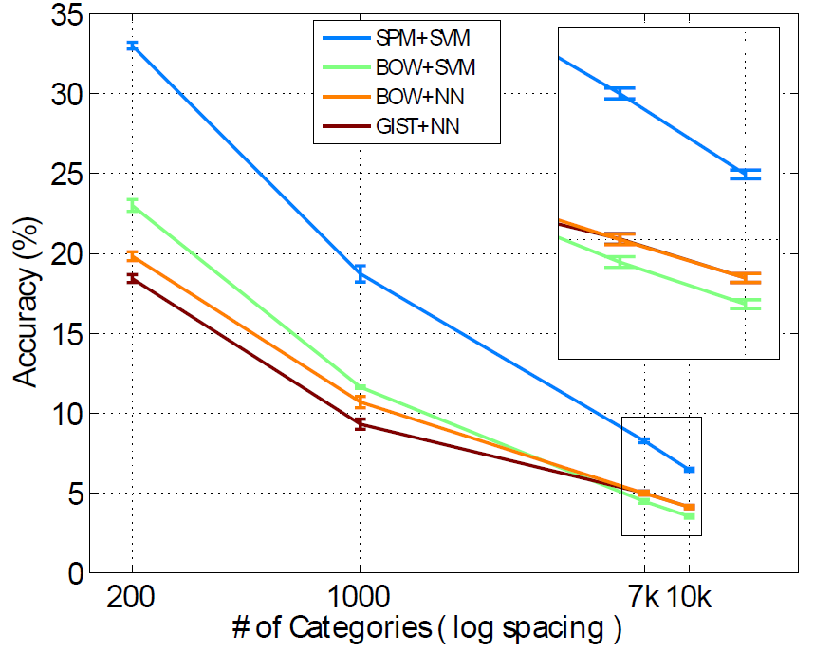
Learn to Classify 10K Classes
9 Million images
4 methods
SPM+SVM [Lazebnik et al. ’06]
BOW+SVM [Csurka et al. ’04]
BOW+NN
GIST+NN [Oliva et al. ’01]
6.4% for 10K categories
Deng, Berg, Li, & Fei-Fei, ECCV2010
Notes:
So they took 9 millions images, which is the entire ImageNet at the time and evaluated 4 state of the art methods, including spatial pyramid plus SVM. It was the first time anybody has tried anything on 10K object classes. Due to time I’ll skip the nitty-gritty details about how we scaled up the methods to work on 10K classes and 9 million images. But I’ll tell you the result. What do you expect the performance to be given that the chance is one out of 10K? It turns out that the accuracy drops to 6.4% for 10K classes. This results was in fact much higher than we expected. On the other hand, it is too low for a practical application. How do we improve the accuracy? Let’s now take a look at what the errors are like.

Slide 34
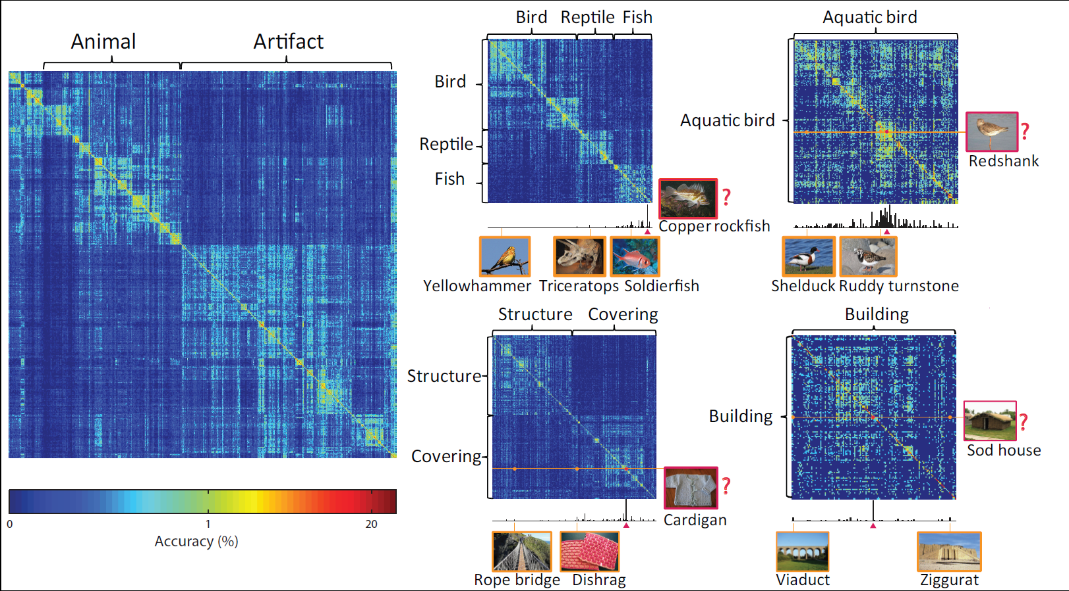
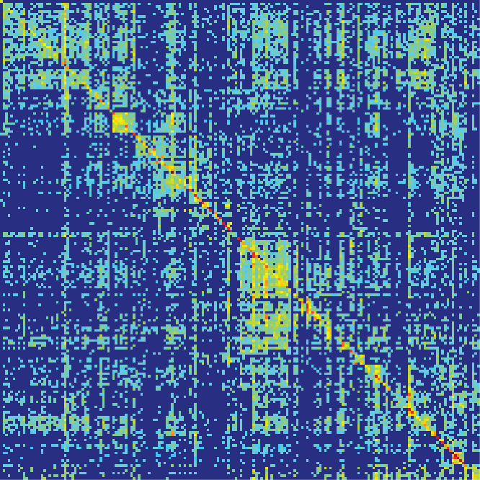
Learn to Classify 10K Classes
Deng, Berg, Li, & Fei-Fei, ECCV2010
Notes:
So we plotted this confusion matrix. Here the columns are order by a DFS of the semantic hierarchy. It means that nearby columns are semantically similar. We can clearly see a block pattern that’s also hierarchical. This indicates that a major source of error is the fine-grained, semantic similar classes, such as different types of dogs, birds, cars.

Slide 35
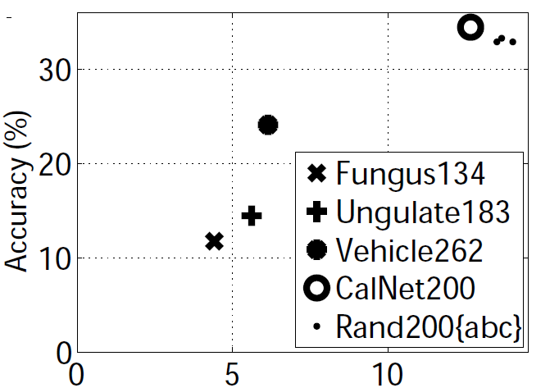
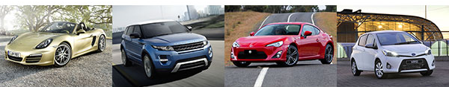
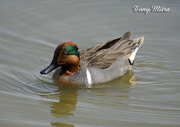
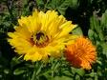
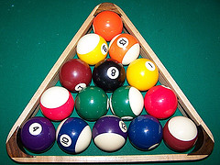
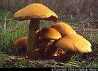
Fine-grained categories are a lot harder
Entity
Entity
Artifact
Artifact
Vehicle
Vehicle
Average Semantic Distance
Finer
Coarser
Deng, Berg, Li, & Fei-Fei, ECCV2010
Notes:
To further confirm this, we did a control experiment that compares the classification accuracy of about 200 classes sampled in different ways. For example, we can sample 200 classes only from the vehicle subtree. [click] Or we can sample it uniformly from all the 10K classes. [click] The 200 vehicles are finer grained while the 200 random classes are coarser grained. [click] This plot shows how the classification accuracy changes with the way we sample our classes. The X axis is the average semantic distances between classes. Here we clearly see that finer-grained classes are much more difficult.

Slide 36
Challenges
Semantic hierarchy
Fine-grained classes
Large-scale Learning
Notes:
Rich structure. Fine-grained. Textureless.

Slide 37
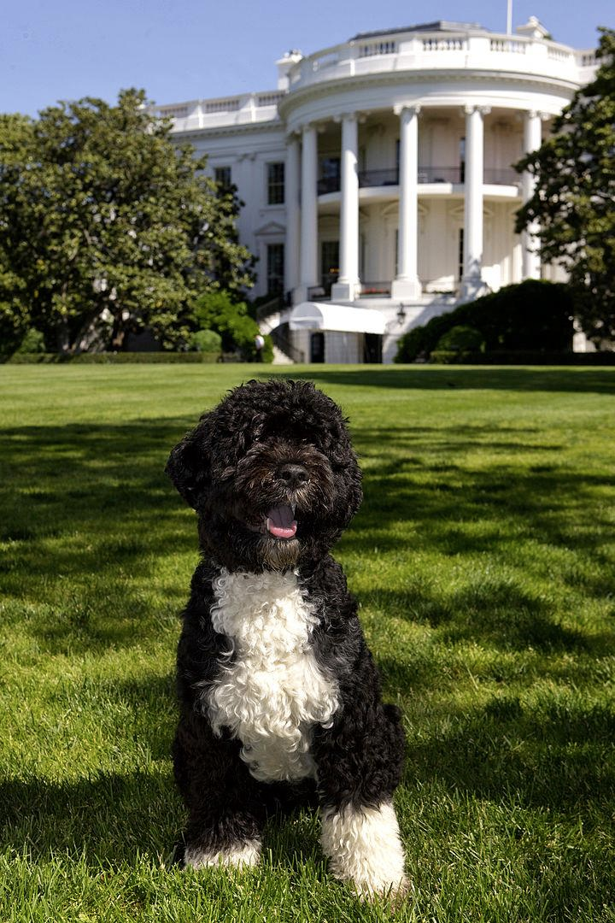
Entity
Certainty
Animal
Dog
Portuguese water dog
Bo, the first dog
Notes:
That is, we are working at the bottom of the semantic hierarchy. The problem is that even if we can get satisfactory accuracy at the bottom, the hierarchy can always sub-divide and expand. For example, we can demand the machine to say that this is the first dog of united states instead of just Portuguese water dog. But if we are willing to move up the hierarchy, we will become more and more certain and we are 100% sure that ultimately everything is an entity.

Slide 38
Entity
Animal
Let’s describe at this level
Dog
But it wastes capacity
Portuguese water dog
Bo, the first dog
Notes:
So the problem is that we’d like to find a semantic level to describe things accurately. For example, we can merge all the dogs and only describe at this level. However, it wastes our classification capacity. Because there is a significant amount of time we can confidently predict the breed.

Slide 39
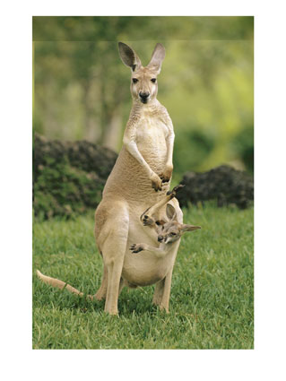
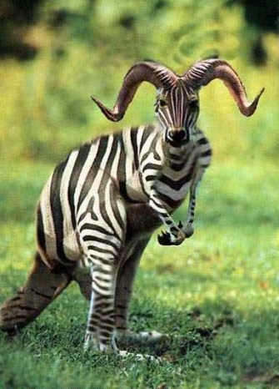
Hedging: Be as informative as possible with few mistakes
Entity
Mammal
…..
✓
…..
Kangaroo
Zebra
Kangaroo
Entity
Mammal
…..
✓
…..
Mammal
Zebra
Kangaroo
Deng, Krause, Berg, Fei-Fei, CVPR2012
Notes:
So people came up with a better idea called “hedging”. For each individual image, we’d like to be as informative as possible while making almost no mistakes. For example, for this easy image, we will confidently go down the hierarchy and predict it as a kangaroo. For this guy, which is very ambiguous, we will hedge and simply say it’s a mammal.

Slide 40
Formal Problem Statement
entity
mammal
vehicle
zebra
kangaroo
boat
car
Deng, Krause, Berg, Fei-Fei, CVPR2012
Notes:
Now let’s state the problem formally. We are given a semantic hierarchy.

Slide 41
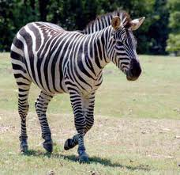
Formal Problem Statement
entity
All Correct
mammal
vehicle
zebra
kangaroo
boat
car
Deng, Krause, Berg, Fei-Fei, CVPR2012
Notes:
And the rule is that if you predict any node that’s an ancester of the ground truth leaf node, it is all considered correct. For example, you can call this image an zebra, a mammal or an entity.

Slide 42
Formal Problem Statement
entity
$0
All Correct
mammal
$1
vehicle
$2
zebra
kangaroo
boat
car
Deng, Krause, Berg, Fei-Fei, CVPR2012
Notes:
But clearly we prefer a prediction of zebra than entity. So we will also setup a reward to measure how specific the prediction is. The reward can be defined according to applications. For example, we can define the reward as the number of bits in this prediction.

Slide 43
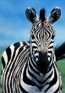

Formal Problem Statement
Assumptions
Same distribution for training and test.
A base classifier g that gives posterior probability on the hierarchy.
Goal
Find a decision rule f
Expected accuracy A(f) is at least 1-ε
Maximize expected reward R(f)
$\vec{r}$: rewards of the nodes.
Reward $R(f, \vec{r})$ : rewards of the classifier
Accuracy $Φ\left(f\right)$ : accuracy of the classifier
g
f
Test image
posterior for all nodes
Deng, Krause, Berg, Fei-Fei, CVPR2012
Notes:
Now let’s state the full problem. We assume the same distribution of training and testing examples. We also assume that we have learned a classifier that can give posterior probability on the hierarchy. For example, we can learn a multi-class classifier on the leaf nodes, and for each test image, we can get the probabilities on the leaf nodes and sum them to get probabilities for internal nodes. Our goal is to find a decision rule f that takes the posterior probability and outputs a node on the hierarchy. We want this decision rule to maximize the expected reward its predictions produce subject to a constraint that accuracy of its predictions must be above a threshold 1-epsilon. Essentially, we are saying that given a particular distribution of images, we want you to be at least 95% correct, and do the best you can to collect as much reward as possible. At this point you may wonder what’s the big deal here, because intuitively given a test image, one should just go down the hierarchy as much as possible until you are about to violate the accuracy constraint.

Slide 44
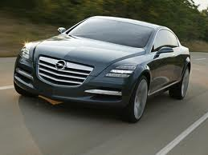
Naïve Solution
Pick a global confidence threshold T=0.9
[Vailaya et al. ’99]
1.0
$0
1.0
$0
Another 100 images
$1
0.90
100 images
0.90
$1
0.80
0.6
$2
$10
Reward = ($1 * 0.90 + $1 * 0.90) / 2 = $0.90
Accuracy = (0.90 + 0.90 ) / 2 = 0.90
$\vec{r}$: rewards of the nodes.
Reward $R(f, \vec{r})$ : rewards of the classifier
Accuracy $Φ\left(f\right)$ : accuracy of the classifier
Deng, Krause, Berg, Fei-Fei, CVPR2012
Notes:
Indeed, this is the solution offered by previous work. Let’s look at a concrete example and I’d like to show you why this is not optimal. Suppose we have 100 images that have the same posterior probabilities as shown here and they are going down the hierarchy following this path. Let’s say we want the accuracy to be at least 90%, then we will stop at here. So these 90 out 100 of those images will be correct and these 90 images will collect 1 dollar each. [click] Now suppose there is another set of 100 images that will go down another branch of the hierarchy. And similarly they will stop here to not go below 90%. For these 100 images, 90 of them will be correct and 90 of them will collect $1 each. [click] Now we can compute the average reward and accuracy. We are 90% accurate and we collect 90 cents on average. Is this the best we can do? It is actually not. We can observe that there is a $10 reward here. So one idea is, maybe we can take more risk here.

Slide 45
Naïve Solution
Pick a global confidence threshold T=0.9
[Vailaya et al. ’99]
1.0
$0
1.0
$0
Another 100 images
$1
0.90
100 images
0.90
$1
0.80
0.6
$2
$10
Reward = ($1 * 0.90 + $1 * 0.90) / 2 = $0.90
Accuracy = (0.90 + 0.90 ) / 2 = 0.90
1.0
$0
1.0
$\vec{r}$: rewards of the nodes.
Reward $R(f, \vec{r})$ : rewards of the classifier
Accuracy $Φ\left(f\right)$ : accuracy of the classifier
$0
T=0.95
Another 100 images
$1
0.90
100 images
0.90
$1
T=0.80
0.80
0.6
$2
$10
Reward = ($0 * 1.0 + $10 * 0.80) / 2 = $4
Accuracy = (1.0 + 0.80 ) / 2 = 0.90
Deng, Krause, Berg, Fei-Fei, CVPR2012
Notes:
Indeed, here’s one way we can do better. Instead of using one global threshold, we will use different thresholds for different branches. For example, we can be very conservative here so all examples here are predicted entity and 100% correct. And we can take more risk here. We will make more mistakes here but we get much more reward by going down a level. On average the accuracy is still 90% but the reward is $4 dollar instead of 90 cents.

Slide 46
Naïve Solution
T₁
T₂
T₅
T₃
T₄
T₆
T₇
We can optimize individual thresholds…
$\vec{r}$: rewards of the nodes.
Reward $R(f, \vec{r})$ : rewards of the classifier
Accuracy $Φ\left(f\right)$ : accuracy of the classifier
But actually we don’t need to.
There is a simpler and provably optimal solution
Deng, Krause, Berg, Fei-Fei, CVPR2012
Notes:
So I have shown you a way to do better than the naïve solution. That is we can set individual thresholds for each node and tweak them. [click] However, we actually do not have to do this. We found a much simpler yet provably optimal solution. And shockingly, it has only one parameter to optimize.

Slide 47
A global, fixed scalar parameter λ≥0
Increase each reward by λ
λ
Test image
Expected rewards
Predict the best
posterior for all nodes
Deng, Krause, Berg, Fei-Fei, CVPR2012
Notes:
Here’s how it works. We have only one global, fixed scalar parameter called lambda. Given a test image, we get the posterier probabilities for all nodes. Then we increase the reward we assigned to each node by lambda. Then we compute the expected reward for each node by multiplying the posterior with the increased reward. Then we predict the node with the best expected reward. What does lambda do? Suppose lambda is infinity, what happens is that all nodes will have equal reward because everybody is infinity. Now the node with the best expected reward will be the root node, because its posterior probability is always 100%. So as lambda increases, the decision will be more accurate but less specific.

Slide 48
Measure
( on validation)
Accuracy ≈ 1-ε?
Pick a λ
Decision rule f with λ
Binary search
N
Accuracy
1-ε
λ
Theorem: Under very mild conditions, this is optimal.
Deng, Krause, Berg, Fei-Fei, CVPR2012
Notes:
How do we set lambda? Here’s the algorithm. We will pick a lambda, then run the decision rule on a validation set, and measure its accuracy. It the accruracy is very close to our threshold 1-epsilon, we stop, otherwise we pick a new lambda. How do we pick a new lambda? It turns out that the we can prove that under very mild conditions the accuracy is continuously and monotonically increasing with lambda, so we can use binary search to find the lambda. We can actually prove that with very mild assumptions this whole procedure is optimal.

Slide 49
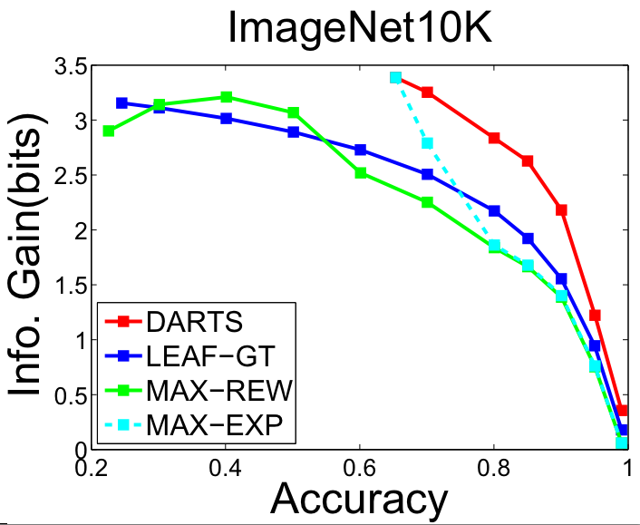
Ours
LEAF-GT
MAX-REW
MAX-EXP
Deng, Krause, Berg, Fei-Fei, CVPR2012
Notes:
It is also supported by empirical evidence. This is on 10K classes. The X axis is the accuracy. The Y axis is the reward, specifically the information gain. The red curse is ours and other curves are various baselines. We see that at any given accuracy, we can obtain much better reward.

Slide 50

www.image-net.org/eva
Notes:
This algorithm forms the basis of our recognition engine on 10K classes. This is the URL. Let’s first look at some results together.

Slide 51


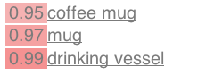
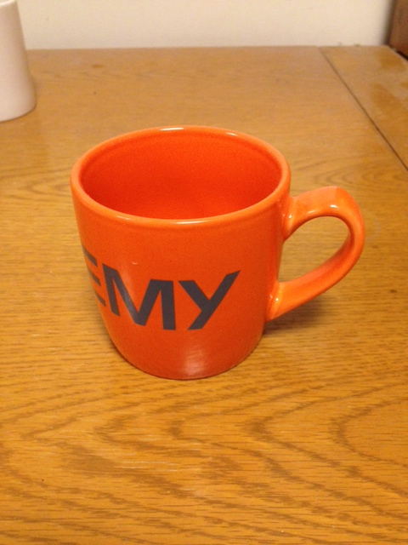
Notes:
It recognize my coffee mug. At 99% it says that it’s a drinking vessel. If we lower the accuracy requirement, it will be more specific and say it’s a coffee mug at 95%.

Slide 52
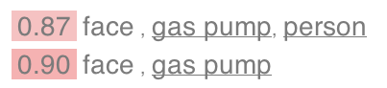
Notes:
It recognizes this gas pump. Note that here we actually segment the images first and then classify the segments. So you will see labels for multiple objects.

Slide 53


Notes:
What about this guy. It’s hard. But at 87% it says “animal”. At 75% percent it makes some mistakes but it thinks there is a vertebrate, which is actually correct.

Slide 54

Notes:
What about President Obama’s credit card? Well it doesn’t get that yet. But we will get there.

Slide 55
Challenges
Semantic hierarchy
Fine-grained classes
Large-scale Learning
Notes:
Rich structure. Fine-grained. Textureless.

Slide 56
Learn to Classify 10K Classes
Deng, Berg, Li, & Fei-Fei, ECCV2010
Notes:
So we plotted this confusion matrix. Here the columns are order by a DFS of the semantic hierarchy. It means that nearby columns are semantically similar. We can clearly see a block pattern that’s also hierarchical. This indicates that a major source of error is the fine-grained, semantic similar classes, such as different types of dogs, birds, cars.

Slide 57
Fine-grained categories are a lot harder
Entity
Entity
Artifact
Artifact
Vehicle
Vehicle
Average Semantic Distance
Finer
Coarser
Deng, Berg, Li, & Fei-Fei, ECCV2010
Notes:
To further confirm this, we did a control experiment that compares the classification accuracy of about 200 classes sampled in different ways. For example, we can sample 200 classes only from the vehicle subtree. [click] Or we can sample it uniformly from all the 10K classes. [click] The 200 vehicles are finer grained while the 200 random classes are coarser grained. [click] This plot shows how the classification accuracy changes with the way we sample our classes. The X axis is the average semantic distances between classes. Here we clearly see that finer-grained classes are much more difficult.

Slide 58

Fine-Grained Recognition
Entity
Animal
?
Dog
What breed is this dog?
Basic category known.
Object already localized.
Notes:
In particular, we’d like to isolate the problem. Instead of tackling all 10K classes, we’d like to carve out this local semantic neighborhood and ask questions like what breed is this dog? Here we are assuming that we already know the basic category and the object has already been localized.

Slide 59




Fine-Grained Recognition
…
Cardigan Welsh Corgi
?
…
What breed is this dog?
Pembroke Welsh Corgi
Key: Find the right features.
Notes:
Now, what’s the key to fine-grained recognition? Let’s look at this dog, what breed is it? It turns out that it looks like these two, cardigan welsh corgi and pembroke welsh corgi. Which one is it? In fact, to make the right classification, we need to look at the tails. One breed has a longer tail than the other. So the key is finding the right features.

Slide 60
Fine-Grained Recognition
Existing Work
Feature Selection from all possible locations
…
Cardigan Welsh Corgi
…
[Branson et al. '10]
Pembroke Welsh Corgi
[Bo et al. '10]
[Farrell et al. '11]
[Yao et al. ’11]
[Yao et al. ’12]
Notes:
How is existing work tackling this challenge? We found that all previous work is trying to have machines do automatic feature selection by looking at all possible locations. This can be a tough task for machines because a large number of features do not matter.

Slide 61
Fine-Grained Recognition
Existing Work
Feature Selection from all possible locations
…
Cardigan Welsh Corgi
…
[Branson et al. '10]
Pembroke Welsh Corgi
[Bo et al. '10]
[Farrell et al. '11]
[Yao et al. ’11]
Can fail to find the right features.
[Yao et al. ’12]
Notes:
And machines can fail to find the right features. Or more specifically, it can be easy to overfit.

Slide 62




Crowd-Machine Collaboration
Question
VS
VS
VS
?
?
Machine
Crowd
VS
Answer
VS
VS
Notes:
To tackle this issue, people proposed to ask the internet and more specifically the crowd for help. This gives us a crowd-machine collaboration framework. [click] for example, the machines can ask the crowd about these difficult categories [click] and the hypothesis is the crowd can provide helpful information, in this case, the locations of the discriminative features. And then the machine can incorporate this information in learning and improve its own performance. In this framework, the key research questions are how we can get good ansewrs from the crowd and how the machines can incorporate the input from the crowd.

Slide 63
Crowd-Machine Collaboration
VS
VS
?
Crowd
VS
VS
Notes:
Let’s start with the crowd side. The key question is how we can get good answers from the crowd about the discriminative features.

Slide 64



Bubbles [Gosselin & Schyns, ’01]
VS
Smiling
Neutral
?
Random Bubble Mask
Notes:
It turns out that the same question has long intrigued psychologists. There is a classical psychophysics technique called bubbles that can answer this question. Suppose we are interested in how humans distinguish smiling faces versus neutral ones. In this experiment, we show human subjects images of both types of faces. However, instead of showing the entire image, we will mask the image and only reveal areas under a random set of bubbles. Then we ask the human subjects to classify the faces.

Slide 65


Bubbles [Gosselin & Schyns, ’01]
VS
Too costly
Smiling
Neutral
Notes:
We will repeat it for many times with different bubbles and pick the masks that would lead to correct classifications. Then we can average those masks and discover the important regions that human use. There is, however, one issue. It is essentially a random search and we would need to perform many many trials, which can be very costly. What would be a more cost-effective way?

Slide 66

Annotation Rationale
[Donahue & Grauman ’11]
No easy quality assurance
What makes the form of the skater good?
Notes:
Well, we can simply ask the question directly to the crowd. Here, for example, we can ask humans to specify the regions that are important. However, there is another issue. That is, there is no easy quality assurance. Because it is, after all, a open-ended and subjective task.

Slide 67
?
Gosselin &
Schyns ’01
Donahue &
Grauman ’11
GAMES
Cost Effective
✗
✔
✔
Quality Assurance
✔
✗
✔
Notes:
So what we really want is an approach that is cost effective and also has a mechanism for quality assurance. What would be something that satisfies both? One solution is games.

Slide 68

Peekaboom [Ahn, Liu, Blum ’06]
Does not work for fine-grained classes
Notes:
There is actually a game called peekaboom that has elements of the bubbles technique. Here we have two players. The left player sees an image and a word, in this case, “cow”. Her job is to click on the images to communicate to the other player that this is a cow. The right player only sees what the left player clicks. And the right player’s job is to type the word “cow”. If she manages to do that, the game succeeds. However, this is also a problem. It does not work for fine-grained classes, because you can’t normally expect someone to be able to type “cardigan welsh corgi” or “BMW X3 2011”.

Slide 69
?
Gosselin &
Schyns ’01
Donahue &
Grauman ’11
Ahn, Liu, Blum ’06
Cost Effective
✗
✔
✔
✔
Quality Assurance
✔
✗
✔
✔
Fine Grained
✔
✔
✗
✔
Notes:
So we need something new that’s cost effective, has easy quality assurance, and works for fine-grained classes.

Slide 70
The Bubbles Game
J. Deng, J. Krause, L. Fei-Fei. Fine-Grained Crowdsourcing for Fine-Grained Recognition. CVPR 2013.
Notes:
So we came up with a game, which we call the bubbles game, paying tribute to the original bubbles technique in psychology.

Slide 71






Let’s play
?
Notes:
Let’s try to play it. This is a single player game. Here I am showing you two types of cars, one on the left, the other on the right. Now your job is to tell me what the car in the center belongs to, left or right. Can you do that? It must be difficult or next to impossible. Because the center image is heavily blurred.

Slide 72
Let’s play
1
2
?
Notes:
Now, I am offering you two choices, bubble 1 and bubble 2. And you can choose one of them to see the full details under it. Which one would you choose? Raise your hand if you choose bubble 1. Raise your hand if you choose bubble 2? You are very good at the game.

Slide 73

Let’s play
?
Notes:
Yes, bubble 1 is the right choice and it will enable you to classify correctly.

Slide 74
Let’s play
?
Notes:
Whereas bubble 2 doesn’t tell you much.

Slide 75

Deng, Krause, & Fei-Fei, CVPR2013
Notes:
That was the classroom version. The crowd version is slightly different. Here you can freely choose where you want to reveal bubbles. Of course, the more you review, you fewer points you would earn. What if I want to cheat by just guessing. Well, if you get it wrong, you are going to lose a lot of points. So you are really encouraged to use bubbles but use it sparingly.

Slide 76











Crowd Picked Bubbles (AMT for now)
70% of games are successful
>90% of successful games use <10% of area
Deng, Krause, & Fei-Fei, CVPR2013
Notes:
We put this game up for the crowd to play. Here are some bubbles we got from AMT players. We found that people can play it really well, 70% of the games are successful. Among the successful games, 90% of them use less than 10% of the image area. So we do get very useful information about what regions are important.

Slide 77




Bubble Heatmaps
Notes:
And we can have multiple players playing the same game and obtain a heat map of bubbles. For example, we can find out that for this bird at the top, the head is very important. And for the bottom one, this red patch is very discriminative. Also it is important to note that as a researcher I am not hand encoding this. So this is a scalable approach to multiple domains.

Slide 78
Crowd-Machine Collaboration
VS
VS
Bubbles Game
VS
VS
Notes:
Now we have a way to get answers from the crowd.

Slide 79
Crowd-Machine Collaboration
Question
VS
VS
VS
?
Machine
Bubbles Game
VS
Answer
VS
VS
Notes:
What about the other side, the machine? The key question is what visual representation the machine should use and how should the machine incorporate the crowd’s input.

Slide 80





BubbleBank Representation
?
A test image
Crowd-picked Bubbles
(on training)
Bubble
Matching
Max-pooling
Linear SVM
Notes:
More specifically, now we have a set of training images from two classes and some bubbles provided by the crowd. How do we classify this test image? Clearly we’d like to check what bubbles appear in the test image. In other words, we want to match the bubbles with the test image. If these bubbles on the left match well, then it’s more likely the test images is the left class. [click]. Specifically, for each bubble we will match the bubble against test image. In particular, we will compare the bubble with every patch in a local neighborhood and takes the maximum matching score. We call this operation max-pooling. The local neighborhood allows some invariance to translation. We will assume that the test image has a similar pose as the bubble image. So the local neighborhood is centered at the same image location. What if the test image has a very different pose? [click] for example for this other bubble it is a different pose. Then we do not expect the bubble to match. Because we have multiple training images, we expect that there will be some bubbles with a similar pose as the test image. [click] After we have a matching score for all bubbles, we can use a linear SVM to make a decision. [click]We call this method the “bubblebank representation”.

Slide 81

V1-like models
BubbleBank
Prior Work
Crowd picked
Clustering random patches
Templates
Pooling
Pool over a single region (spatial prior)
Pool over multiple uniformly sampled regions (e.g. SPM)
[Lecun et al. ’98]
[Csurka et al. ’04]
[Lazebnik et al. ’06]
[Deng et al. ’13]
[Wang et al. ’09]
[Lee et al. ’09]
[Pinto et al. ’09]
[Perronnin et al. ’10]
[Li et al. ’10]
[Coates & Ng ’11].
[Yao et al. ’12]
Notes:
The bubblebank representation belongs to a larger family of models which we call the v1-llike models. V1 is the first stage of visual processing in the human brain. What these models have in common is that they all generate a set of templates, typically by clustering random patches and do spatial pooling. That is, they try to match those templates against certain regions of the test image. Bubblebank differs from prior work in that first the templates are generated from the crowd. Second, we only use one pooling region for each bubble whereas prior work uses multiple, uniformly sampled regions. In other words, we have a strong spatial prior about where each bubble should appear whereas previous work doesn’t assume this.

Slide 82
[Branson et al. '10]
[Farrell et al. '11]
[Yao et al. ’12]
Deng, Krause, & Fei-Fei, CVPR2013
Notes:
Let’s look at some quantitative results. The bluebars are the previous state of the art results on a standard bird dataset. Our result the red bar improves over the previous best by 13 percent. The first orange bar is a control experiment by replacing the crowd-picked bubbles with random bubbles. And the second orange bar is by removing our strong spatial prior. We see in both cases the perfomrance drops significantly. This shows that the two innovations we introduced for bubblebank are essential.

Slide 83

Top Activated Bubbles
Deng, Krause, & Fei-Fei, CVPR2013
Notes:
Let’s also look at some qualitative results. Here I am showing a test image and the top activated bubbles. Often the eyes are very important but we are not handcoding this information. Instead this is taught by the crowd.

Slide 84
Crowd-Machine Collaboration
Question
VS
VS
VS
BubbleBank
Bubbles Game
VS
Answer
VS
VS
Notes:
Now, I have shown you a specific instance of this crwod-machine collaboration framework.

Slide 85
Challenges
Semantic hierarchy
Fine-grained classes
Large-scale Learning
Notes:
Rich structure. Fine-grained. Textureless.

